Slide 1
GERESE—A Faculty Workshop (Graduate Education in Research Ethics for Scientists and Engineering)
William J. Frey
College of Business Administration

Slide 2
What is GERESE?
An interdisciplinary team at UPRM is…
planning, testing and assessing…
a new framework for teaching Research Ethics
Framework :
1. series of workshops for graduate students,
2. separate activities for faculty development,
3. mentoring opportunities for faculty / students,
4. new series of courses on Research Ethics.
Final objective:
Foster and support ethical behavior and social
commitment among researchers in Science and
Engineering.

Slide 3
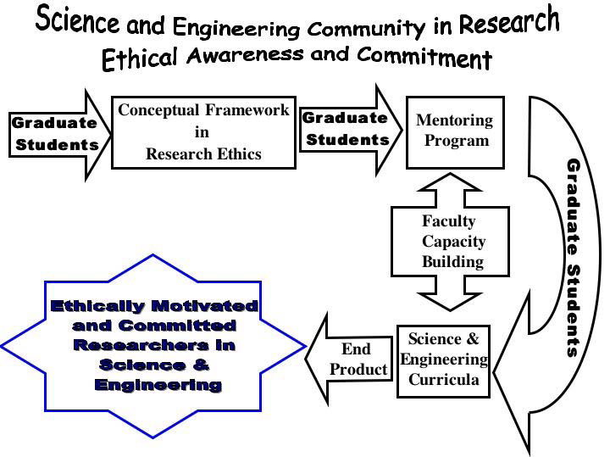

Slide 4
EAC Tookit Team
NSF 0551779:
Collaborative Development of Ethics Across the Curriculum Resources and Sharing of Best Practices
Halley D. Sanchez
Aury Curbelo
Jose Cruz
“online platform that facilitates integrated access, collaborative creation, continual improvement, and interactive dissemination of EAC resources and instructional best practices”
Their Task: Observe workshop and provide outsider’s perspective for post workshop assessment

Slide 5
GERESE Team
NSF 0629377 (Graduate Education in Research Ethics for Scientists and Engineers)
Jorge Ferrer
Didier Valdes
Carlos Rios-Velazquez
Efrain O’Neill-Carrillo
Erika Jaramillo
Morgan Echeverry

Slide 6
Faculty Stakeholders in research ethics
You…
Some of you participated in November 29, 2007 Workshop
You care about research ethics and have special insights into…
Research into your academic domain
Its ethical problems
How your students and colleagues cope
We need your input to…
Further validate issues in research ethics
Assess the components of our project
Assess the “what” and “how” of institutionalization

Slide 7
Agenda
I. Identifying and Validating Research Ethics Issues in the UPRM Context
II. Disseminating GERESE at UPRM: An Overview
III. GERESE Project Assessment
How can project activities be used to address UPRM Research Ethics Issues?
IV. Institutionalizing Research Ethics at UPRM
What do we want to institutionalize in Research Ethics?
How do we go about institutionalizing it?
V. Workshop Assessment

Slide 8
Identify and Validate research ethics issues in the UPRM Context
9:00: Summary of Issues in RE and rankings
9:15: Historical and Theoretical Context of RE
9:45: Mapping UPRM issues onto Theoretical and Historical Context

Slide 9
Workshop: November 29, 2007
Discussed sample cases in research ethics
Brainstormed Issues
Ranked Issues
Participants were given stickers valued from one to five points
Participants then voted by placing colored sticker next to issue

Slide 10
Research Ethics Issues & Rankings
Plagio – 50
Scientific Rigor 45
Authorship 32
Record Keeping 25
Misrepresenting expertise/competence 24
Power Disparity 21

Slide 11
Research Ethics Issues & Rankings
Robo de Ideas 20
Speculate Beyond Data 17
Amiguismo 7
Failure to Follow Through 5
Not reporting what doesn’t work 5
Publish or Perish Effects 1

Slide 12
Historical and Theoretical Context of Research Ethics
Dr. Jorge Ferrer

Slide 13
Validating Research Ethics Issues
Given this discussion of the historical and theoretical context of RE, are there any issues you would like to add, delete, or revise to the November 29 list?

Slide 14
Disseminating GERESE at UPRM
10:30: Workshops for Graduate Students in Research Ethics
10:45: Case Analysis Workshop and Research Ethics Courses
11:00: K-12 Outreach in RE in PR

Slide 15
How can project activities be used to address UPRM Research Ethics Issues?
11:15: Breakout Groups discuss theme
11:35: Plenary Discussion

Slide 16
What do we want to institutionalize in RE? How do we go about institutionalizing it?
1. Introduction for Afternoon discussion of institutionalization
2. Break out groups brainstorm 3 to 5 options
3. Three Ways to Implement Research Ethics: A Benchmark
4. Break out groups refine / integrate implementation options

Slide 17
institutionalizing research Ethics: Benchmarks and Criteria

Slide 18
To institutionalize RE we need…
Administration Buy-In
Faculty Buy-In
“capturing expertise of practitioners”
Senior Faculty
Junior Faculty
Find niche within Organizational Ecology
Curricular niche
Hooking into existing UPRM “entities” (CEP, Graduate School, Research programs, Grant Funding Agencies)
Generating Resources (Financial, Technological, etc)
Recruiting Qualified Faculty (Ethicists and Experienced Researchers)

Slide 19
Student Buy-in?
Our project used active learning strategies like graduate students becoming mentors, case analysis activities, and banquet based on poster presentations

Slide 20
Program | Description | Adminis-trative Buy-in | Faculty Buy-in | Inst. Ecology | Generating Resources | Qualified Faculty
Emory University | 2 day workshop in RE | Ad attended workshops | Yes: due to top down leadership | Integration into curriculum | Univ and grant suppt | Leaders over-extended
University of Pitt. | Workshops, mentoring, courses, | Adminis-tration provides $ | No: Jr faculty not supported | Integration into curriculum | Univ and grant suppt | Leaders over-extended
Open Seminar | Online 1- hour self-guided course | Multi-University NSF initiative | Faculty provide modules | Flexible format | NSF grant | Self-Guided Approach for teachers and students
APPE | Intensive Retreat / student cases | Supported by APPE & Poynter Cntr | Housed in APPE | Housed in APPE | Grant funds | Outside experts (NSF $)

Slide 21
Standalone course
Three Hour Course? (Research Ethics for all areas)
One Hour Course (Tied to Research Area)?
Three Hour Course—Modular Approach?
Small Course or Mega Course?
Recruiting qualified faculty
Help from Graduate Assistants
Limitations of small and mega courses
Cost? (Not as easy to decide as you might think)

Slide 22
APPE--Graduate Research Ethics Education
NSF SBR 9421897
Intensive Exposure to Ethical and Theoretical Components of Research Ethics
Research Ethics Experts (Pritchard, Muskavitch, Vesilind, Johnson, Schrag, Weil)
Graduate students representing different academic areas
Students Write Cases—Experts write commentaries
Spectacularly successful product and experience

Slide 23
Suggestions
Posibles mecanismos:
Group meetings—una vez al mes discutir un caso. El tamaño de un group meeting es ideal para discusiones
Seminarios graduados—similar al anterior pero típicamente participar 30-50 estudiantes
“Ethics Clubs” como “journal clubs” pero no se limitan a un solo profesor. El problema es que es una carga/tarea adicional para los participante

Slide 24
What do we want to institutionalize in RE? How do we go about institutionalizing it?
2:05: Break out groups refine and integrate institutionalization options
2:25: Break out groups debrief leading to a plenary discussion of institutionalization

Slide 25
Workshop Assessment
2:45: Closing remarks and evaluations

Slide 26
Concluding Remarks
Thanks for all your time and hard work…
Stay in Touch…
www.cnx.org
www.eactoolkit.com

